Slide 1

CA4 - CYBERSECURITY
DONE BY
A CH ROHIT E0320022
KUMARESH E0320004
DHRISH S KUMAR E0320008

Slide 2

INTRODUCTION TO CYBERSECURITY
INTRODUCTION
Cybersecurity is a field dedicated to protecting computer systems, networks, and data from unauthorized access, theft, damage, or disruption. It encompasses various practices, technologies, and measures designed to safeguard digital assets and mitigate risks associated with cyber threats.
It plays a crucial role in maintaining the confidentiality, integrity, and availability of information in today's technology-driven society.

Slide 3

TOOLS USED
ACUENTIX
RED HAWK
WIRE SHARK
OPENVAS

Slide 4
PHASES INVOLVED
1. Reconnaissance:
This phase involves searching for information about the target system, such as IP addresses, domains, and web technologies.
2. Enumeration:
Once the initial reconnaissance is completed, the user enumerate further details about the target system, such as open ports, SSL/TLS certificates, and subdomains.
3. Analysis:
After gathering information about the target system, the user can analyze the results to identify potential vulnerabilities, misconfigurations, or other security issues.
4. Reporting:
Finally, the user can generate a report of the findings, which can be used to prioritize
and address any security issues that have been identified.
​

Slide 5
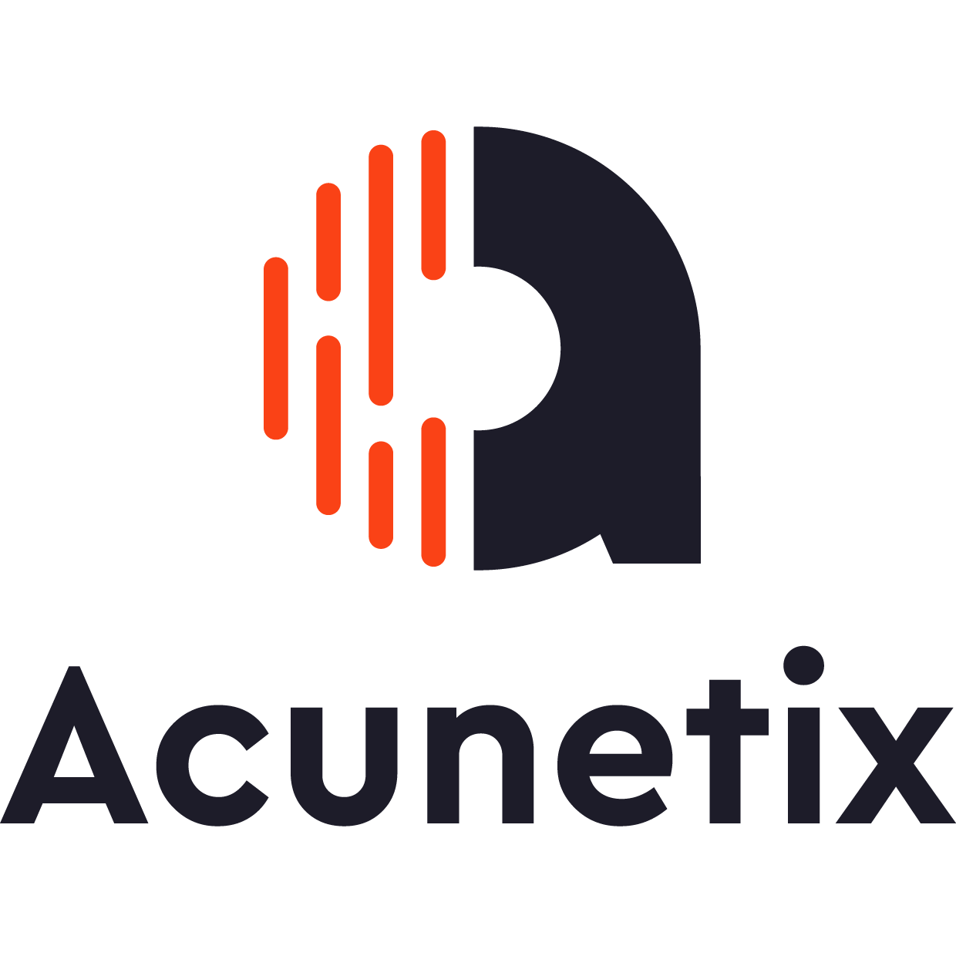
Acunetix Web Vulnerability Scanners
Acunetix Web Vulnerability Scanner is a web application security solution that provides advanced features for detecting and identifying vulnerabilities in web applications.
Automatic Scanning: Acunetix's automatic scanning feature enables users to scan web applications without requiring any manual intervention. The scanner automatically detects web vulnerabilities, such as SQL injection, cross-site scripting (XSS), and file inclusion vulnerabilities.
Advanced Crawler: Acunetix's crawler is designed to identify hidden and complex web pages, including pages that require authentication or contain dynamic content. The crawler is capable of following JavaScript links, handling forms, and parsing XML and JSON data.
Vulnerability Management: Acunetix's vulnerability management feature enables users to track and manage vulnerabilities throughout the software development lifecycle. The feature allows users to assign priorities to vulnerabilities and track their remediation status.

Slide 6
Acunetix Web Vulnerability Scanner
Integration with Other Tools: Acunetix integrates with a wide range of third-party tools, including issue trackers, security information and event management (SIEM) systems, and continuous integration and deployment (CI/CD) pipelines
Reporting and Analytics: Acunetix provides comprehensive reporting and analytics capabilities, including detailed vulnerability reports, vulnerability trend analysis, and compliance reporting. The reports provide a detailed overview of vulnerabilities, their severity, and recommended remediation actions.

Slide 7
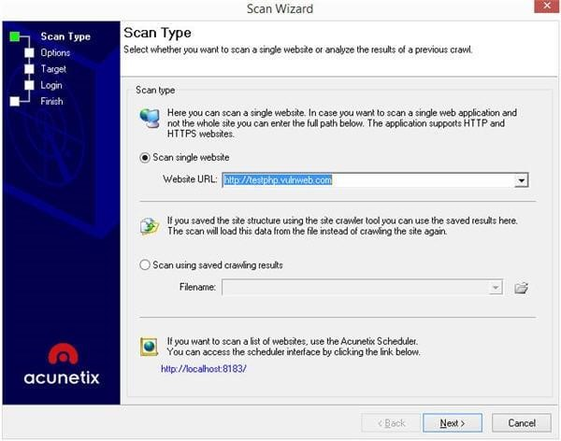
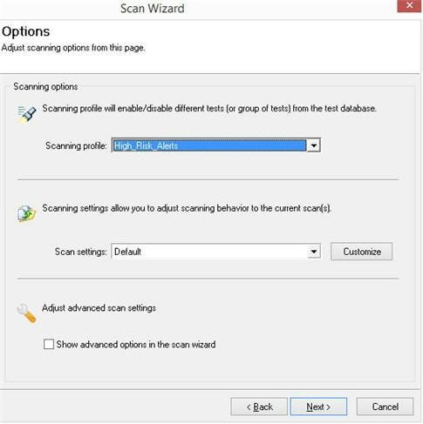
ACUNETIX - PERFORMING ONLINE VULNERABILITY SCAN

Slide 8
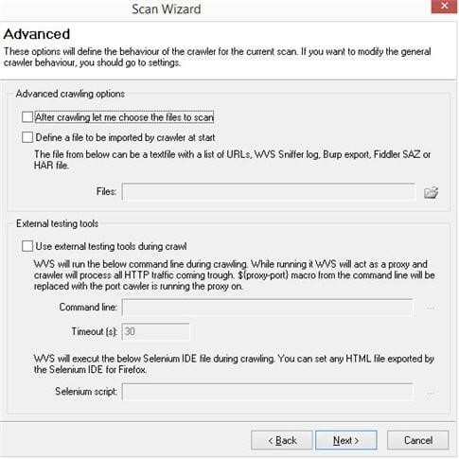
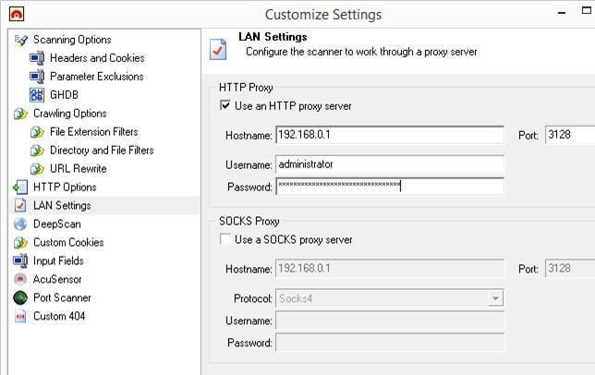
ACUNETIX - PERFORMING ONLINE VULNERABILITY SCAN

Slide 9
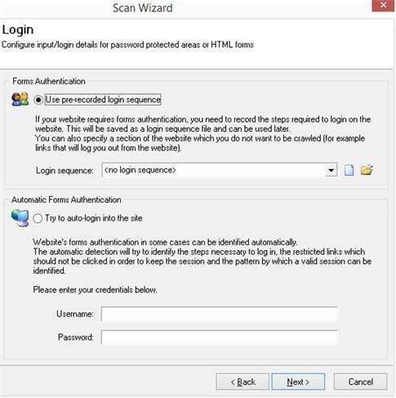
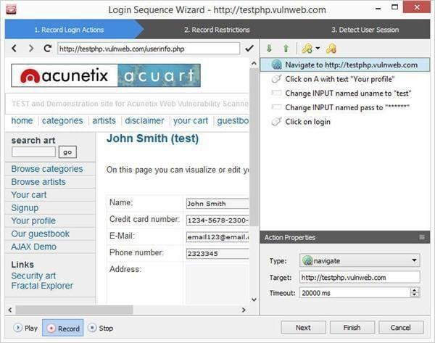
ACUNETIX – SCAN PASSWORD PROTECTED AREAS OF WEBSITE

Slide 10
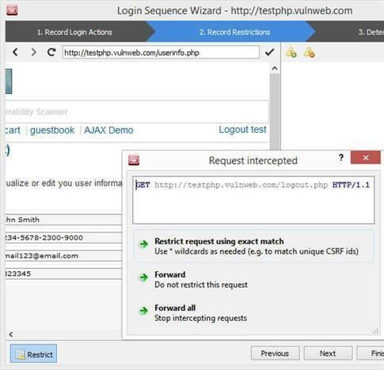
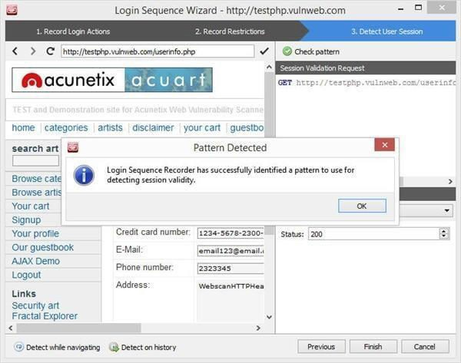
ACUNETIX – SCAN PASSWORD PROTECTED AREAS OF WEBSITE

Slide 11
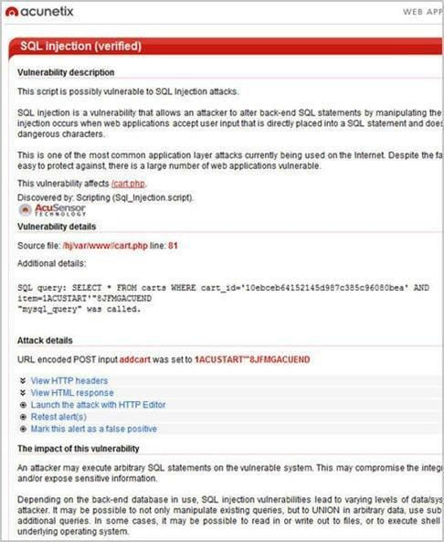
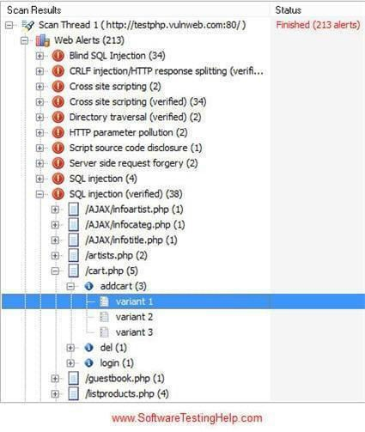
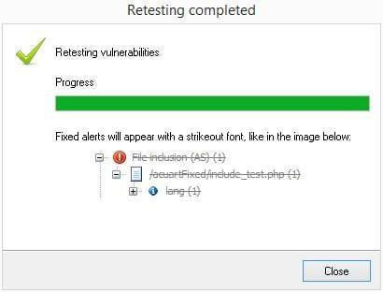
ACUNETIX – WEB VULNERABILITY SCAN RESULTS

Slide 12
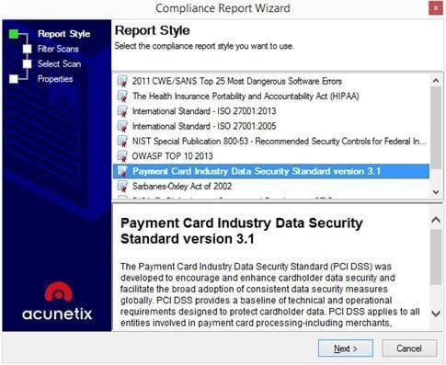
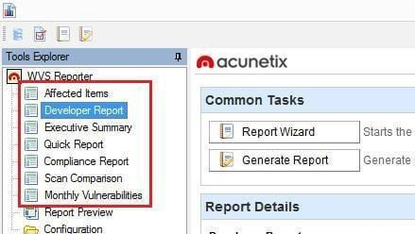
Acunetix – Web Vulnerability Scan Reporting

Slide 13
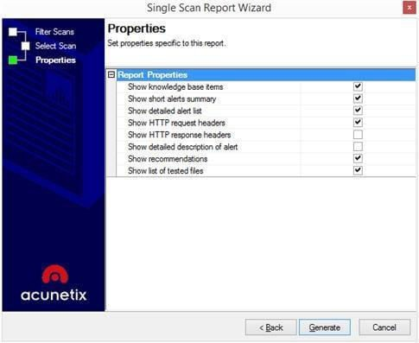
Acunetix – Web Vulnerability Scan Reporting

Slide 14
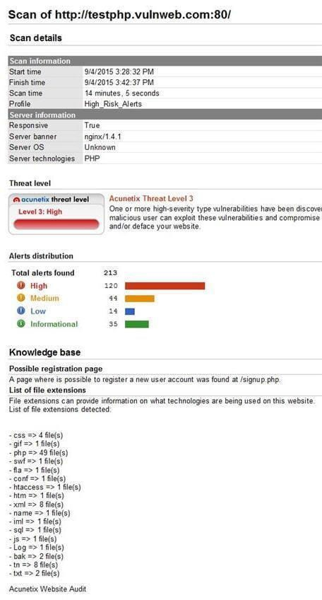
Generating report - Acunetix

Slide 15
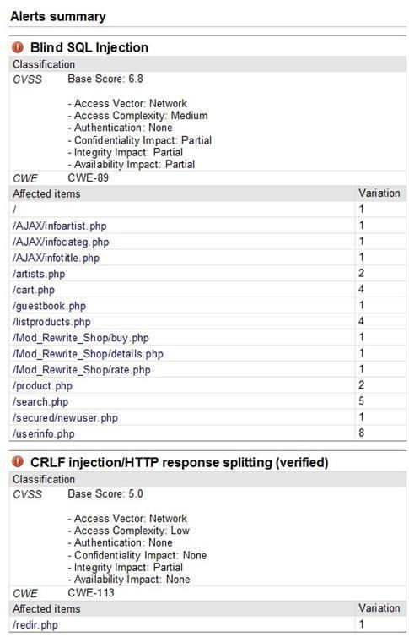
Generating report - Acunetix

Slide 16
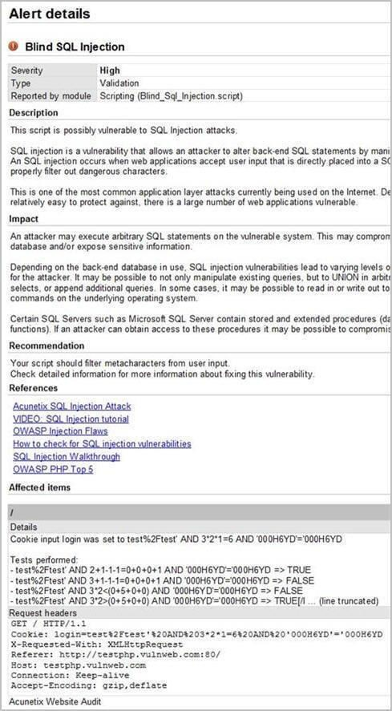
Generating report - Acunetix

Slide 17

RED HAWK
Red Hawk is an open-source tool designed for website reconnaissance and vulnerability scanning.
It offers various features to gather information about a target website, scan for vulnerabilities, and assess its security.
The tool conducts comprehensive information gathering, including obtaining the website's IP address, server details, WHOIS information, geolocation data, and DNS records.
One of the main functionalities of Red Hawk is vulnerability scanning. ​

Slide 18
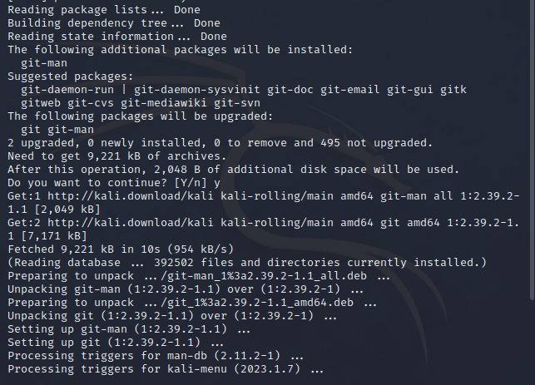

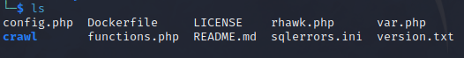
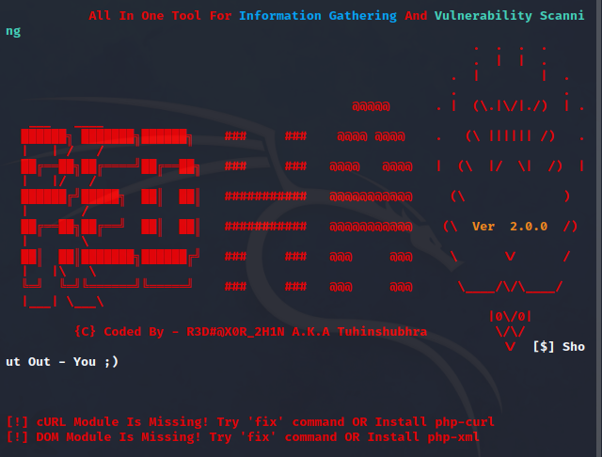
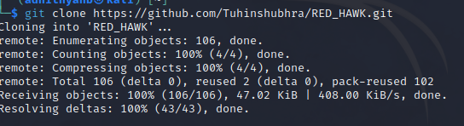
REDHAWK - OUTPUT SCREENSHOTS

Slide 19
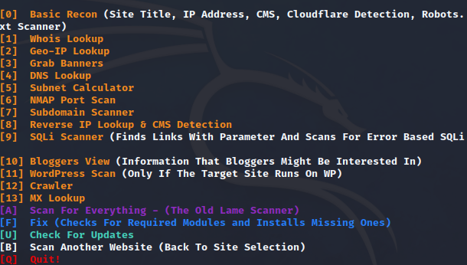
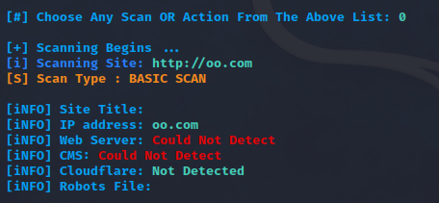
REDHAWK - OUTPUT SCREENSHOTS

Slide 20

Wire Shark
Wireshark is a free and open-source network protocol analyzer.
It is widely used by network administrators, security professionals, and developers to capture, analyze, and troubleshoot network traffic in real-time.
With Wireshark, you can inspect and analyze the packets flowing over a network, helping you understand network behavior, diagnose network issues, and investigate security incidents.
Wireshark is a network or protocol analyzer (also known as a network sniffer) available for free at the Wireshark website. It is used to analyze the structure of different network protocols and has the ability to demonstrate encapsulation. The analyzer operates on Unix, Linux and Microsoft Windows operating systems, and employs the GTK+ widget toolkit and pcap for packet capturing.
Wireshark shares many characteristics with tcpdump. The difference is that it supports a graphical user interface (GUI) and has information filtering features. In addition, Wireshark permits the user to see all the traffic being passed over the network.

Slide 21
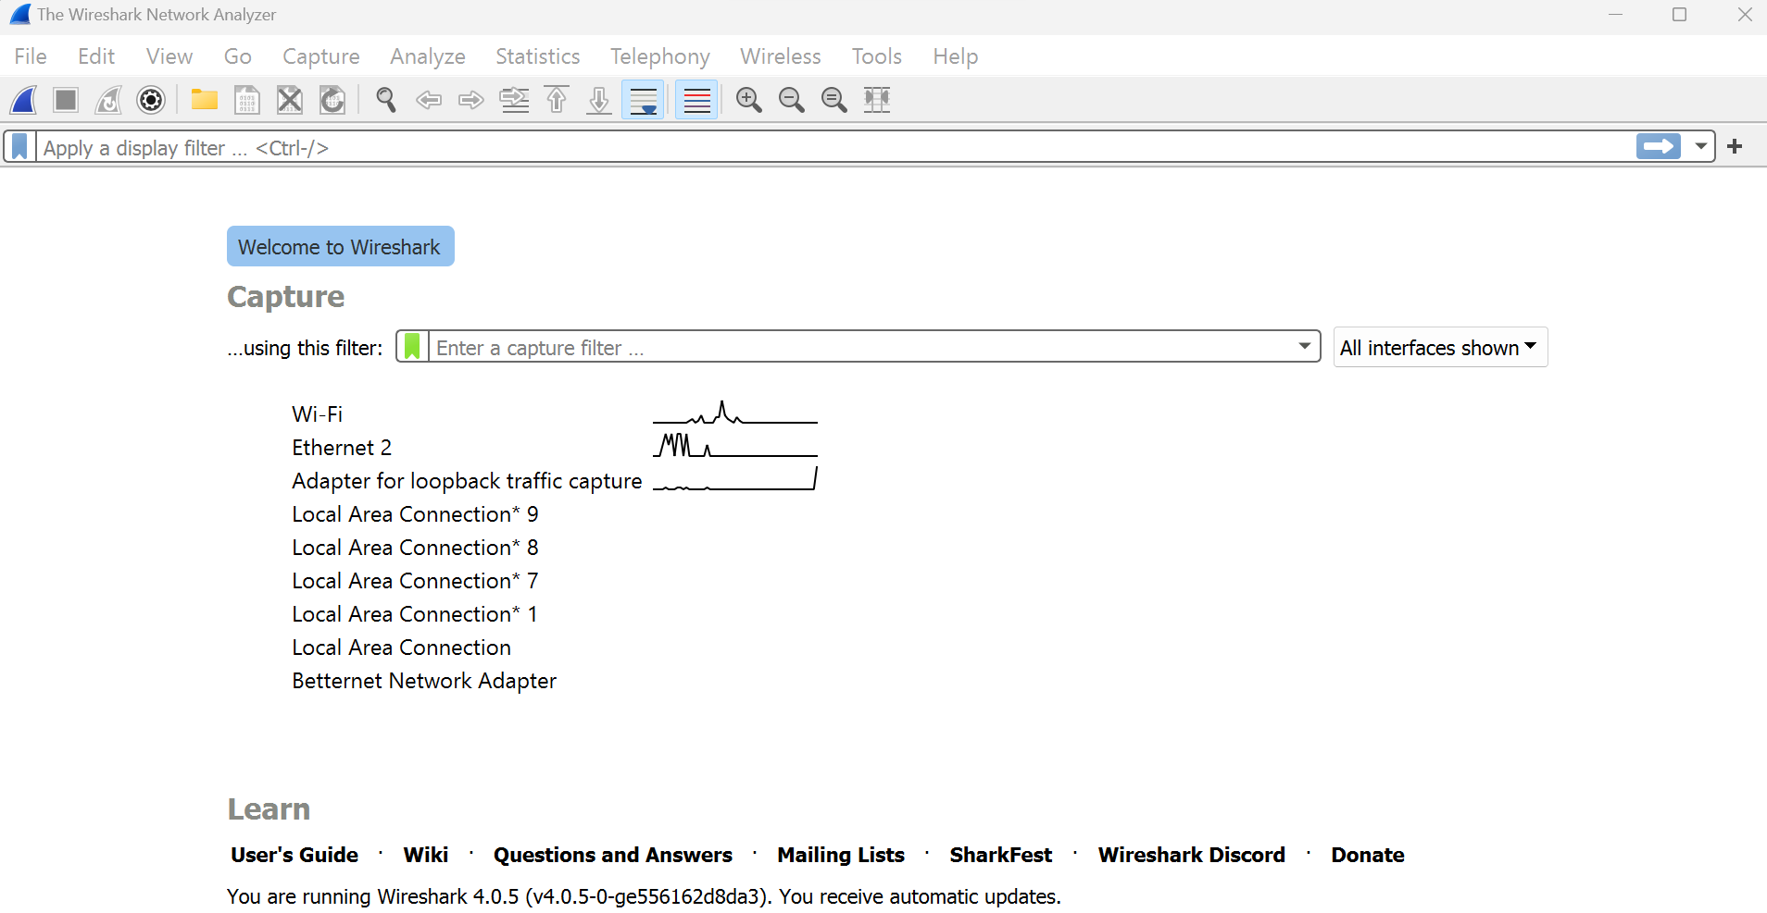
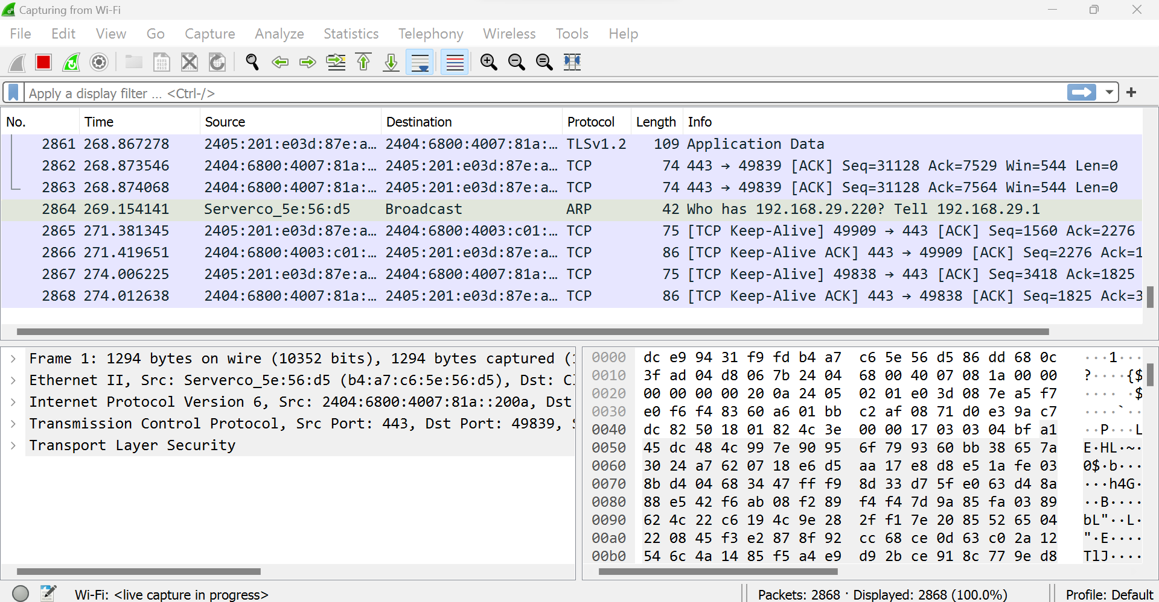
WIRESHARK - OUTPUT SCREENSHOTS
In the Wireshark Capture Interfaces window, select Start.
Select one or more of networks, go to the menu bar, then select Capture.

Slide 22
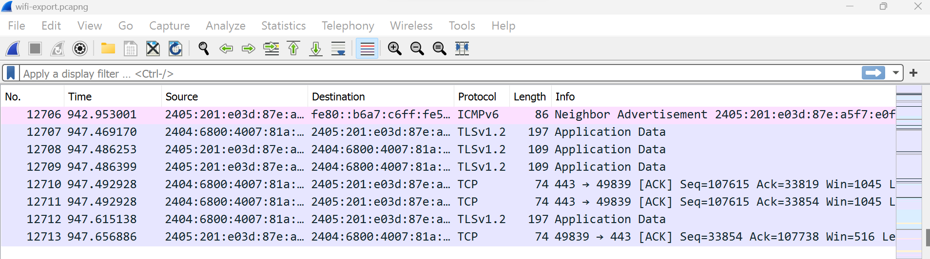
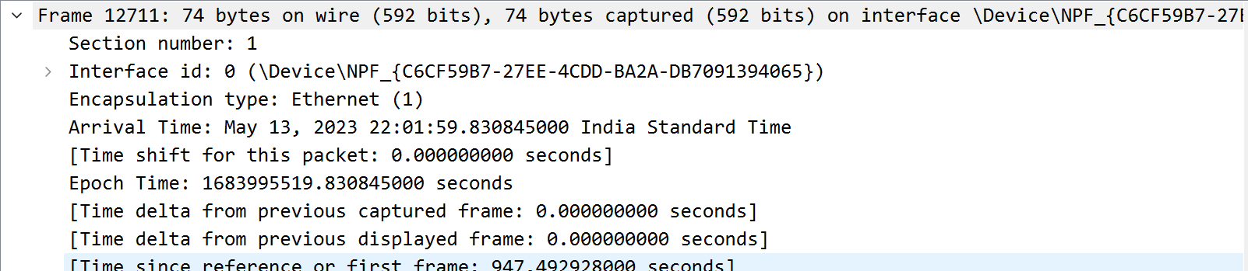
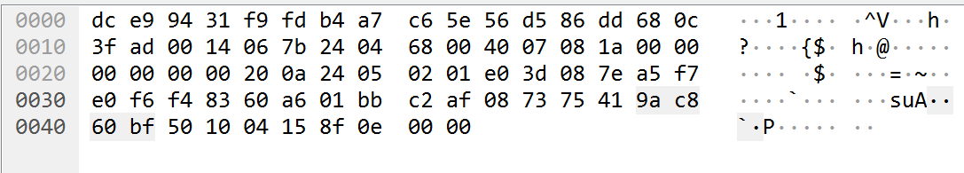
WIRESHARK - OUTPUT SCREENSHOTS
← The packet list pane (the top section)
The packet details pane (the middle section) →
← The packet bytes pane (the bottom section)

Slide 23
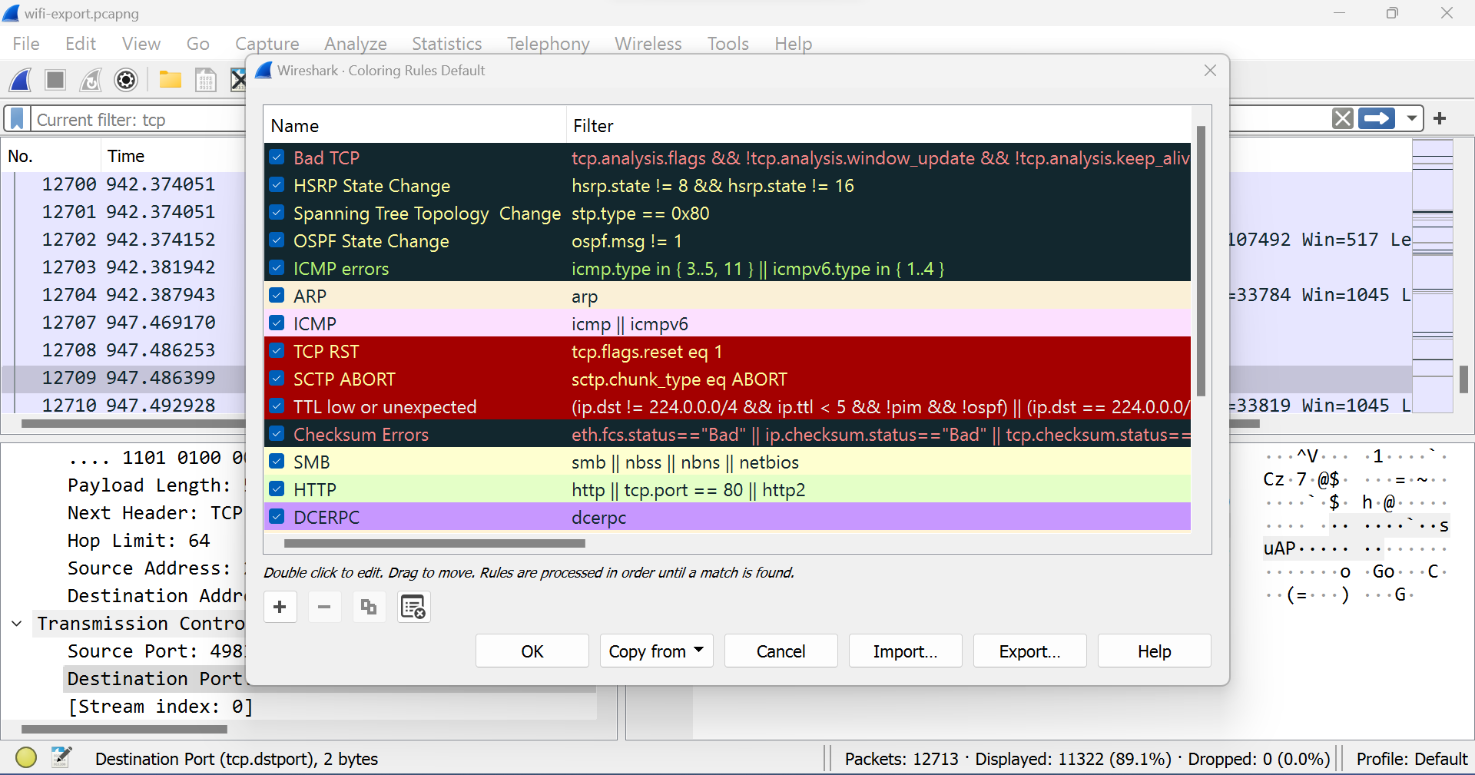
WIRESHARK - OUTPUT SCREENSHOTS
Wireshark Color Rules:
While Wireshark's capture and display filters limit which packets are recorded or shown on the screen, its colorization function takes things a step further: It can distinguish between different packet types based on their individual hue.
This quickly locates certain packets within a saved set by their row color in the packet list pane.

Slide 24

OPENVAS
OpenVAS (Open Vulnerability Assessment System) is an open-source vulnerability scanning and management tool. It is designed to identify and assess security vulnerabilities in computer systems, networks, and web applications,
Configuration: Set up the OpenVAS environment by installing and configuring the necessary components, such as the OpenVAS Scanner, OpenVAS Manager, and OpenVAS Greenbone Security Assistant (GSA). Configure user accounts, permissions, and scan targets.
Target Selection: Define the target systems or networks that will be scanned for vulnerabilities. Specify the IP addresses or domain names of the target assets to be assessed.
Scan Configuration: Configure the specific parameters for the vulnerability scan, such as the scan intensity level, scan timing options, and selection of vulnerability tests. Customize the scan according to the specific requirements and desired depth of analysis.
Scan Execution: Initiate the vulnerability scan by running the OpenVAS scanner. The scanner sends various probes and tests to the target systems to identify vulnerabilities, misconfigurations, or potential security issues.
Vulnerability Assessment: OpenVAS analyzes the scan results and identifies vulnerabilities based on known security issues and weaknesses. It assesses the severity and potential impact of each vulnerability and provides detailed information about the vulnerabilities found.

Slide 25
OPENVAS
Vulnerability Reporting: OpenVAS generates comprehensive reports containing detailed information about the identified vulnerabilities, including their severity, description, and recommended actions for remediation. The reports can be customized and exported in various formats for further analysis and sharing with stakeholders.
Remediation Planning: Based on the scan results and vulnerability reports, develop a remediation plan to address the identified vulnerabilities. Prioritize the vulnerabilities based on their severity and potential impact on the systems and networks. Determine the necessary actions to mitigate or eliminate the vulnerabilities.
Remediation Execution: Implement the remediation actions according to the planned approach. Apply security patches, update software versions, reconfigure systems, or implement other security measures to address the identified vulnerabilities.

Slide 26
OPEN VAS - Procedure
Step 1: Open openvas by typing.
Openvas-start in terminal
Step 2: During first time it will show credentials in terminal.
User-name: Admin
Password: xxx-xxx
Save those on somewhere
Step 3: After that browser will be open automatically prompting the login screen if not [type following address in any browser].
https://127.0.0.1:9392(login page will appear)
Step 4: Now Dashboard page will be open listing major vulnerabilities on the network on Menu bar click on scans bar.
Step 5: On scans click on tasks to create a new task/scan.
Step 6: On task page, there will be a task wizard on topleft corner.
Step 7: It will prompt you enter IP address or hostname to starscan

Slide 27
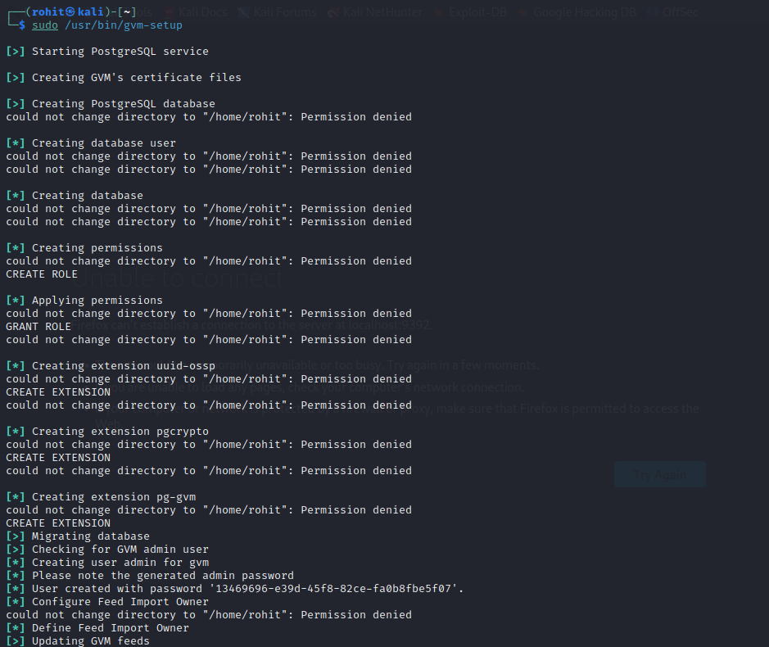
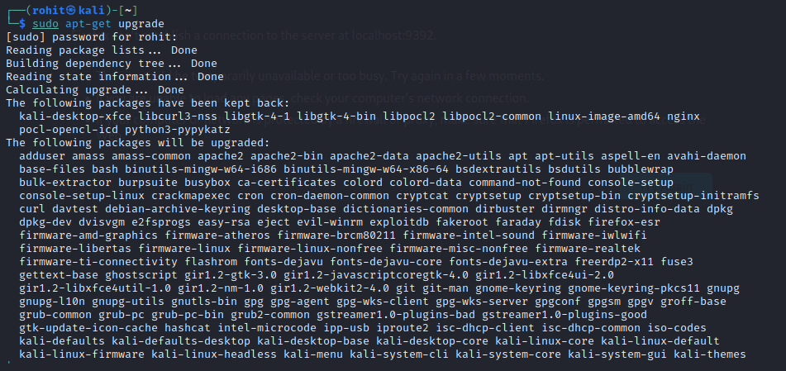
OPEN VAS - OUTPUT SCREENSHOTS

Slide 28
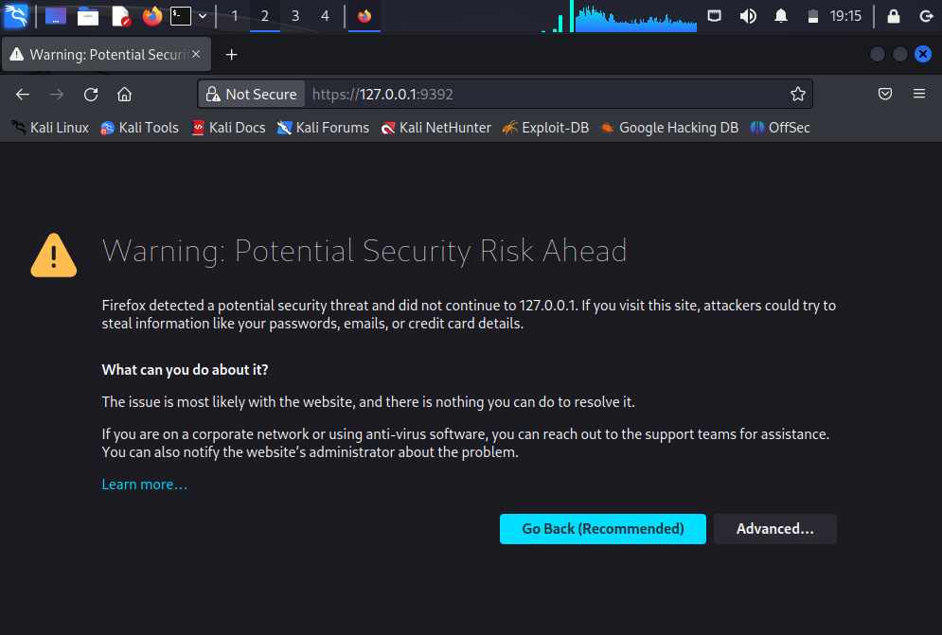
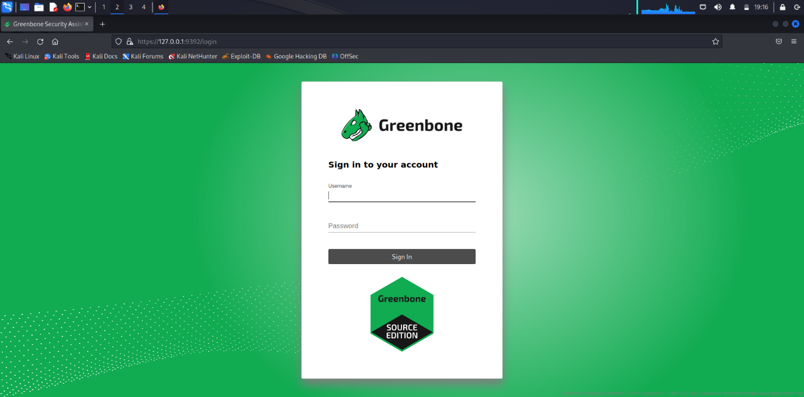
OPEN VAS - OUTPUT SCREENSHOTS

Slide 29

CONCLUSION
In conclusion, cybersecurity is an essential aspect of our digital lives that cannot be ignored. With the rise of cyber threats such as malware, phishing, and social engineering, it is important to stay vigilant and aware of potential risks. Fortunately, there are several tools available to protect against these threats, including antivirus software, firewalls, and encryption. By using these tools and staying informed about the latest cybersecurity trends, we can better protect ourselves and our sensitive information from falling into the wrong hands.

Slide 30

THANK YOU

